Slide 1
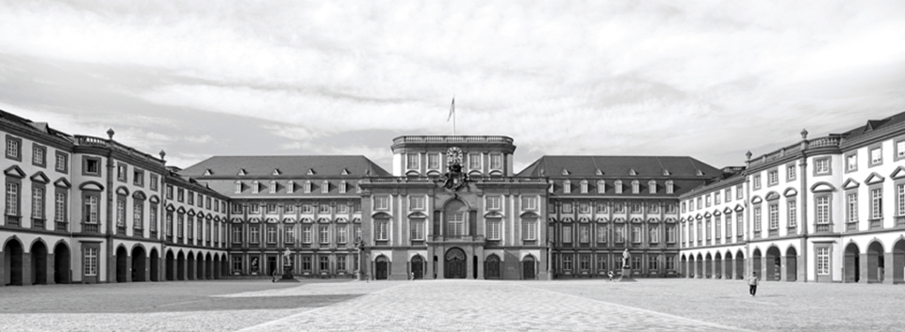


Slide 2
Cross-lingual Ad-Hoc Semantic Retrieval

Slide 3
The goal
To implement the model for cross-lingual retrieval
Notes:
The goal of our project is to design a model which is capable of retrieving relevant documents across languages. Ie. we have a query in English, and we are interesting in retrieving all related documents to this query another language (Spanish).
The problem is the fact that word embedding differ across languages, ie the dense vector of a word Lady is English is different from the embedding of the word Dama in spanish.
In order to achieve semantic comparison across languages we need to find a way to transit our vector space model from one language to another.

Slide 4
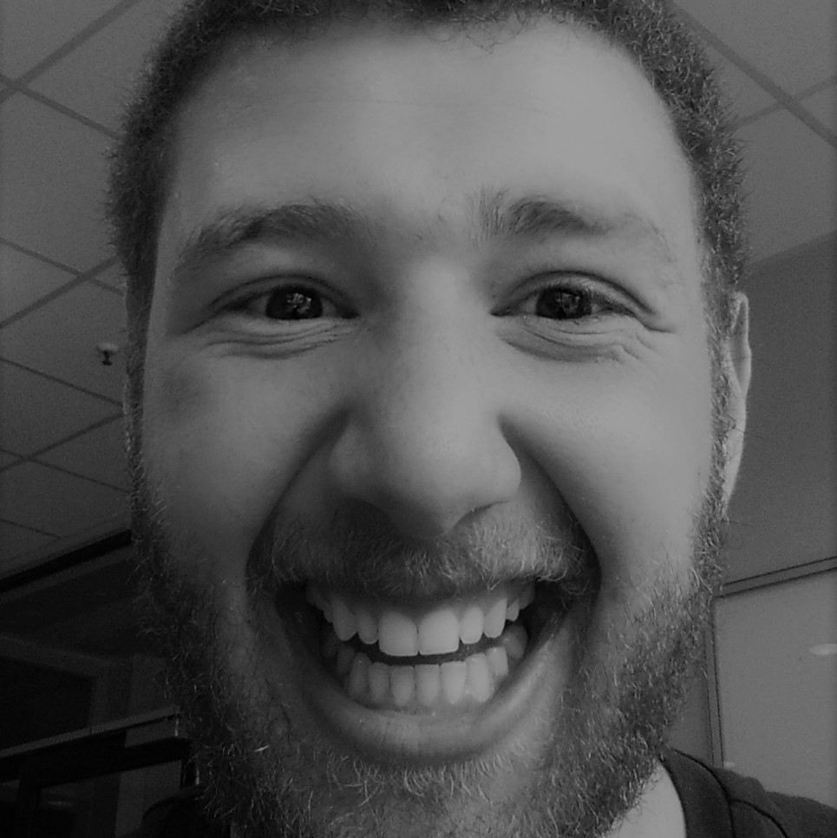
hello!
I am Rafik
I am here because I have to be here.
rtkaiedd@mail.uni-mannheim.de

Slide 5
1.
Translation Matrix
Explained

Slide 6
Translation Matrix
Monolingual word embeddings.
Construct a joint multilingual semantic vector space.
Notes:
We start from monolingual word embeddings of both english and spanish, the embedding where pretrained by using big corpus (wikipedia). The words were represented using GloVe un supervised learning algorithm.
In order to allow for semantic comparison of texts in different languages, we must construct a joint multilingual semantic vector space. To this end, we select the embedding space of one language and map embedding spaces of all other languages to the selected space using the linear translation matrix model of Mikolov
To do this we select the embedding space of one language and map embedding spaces of all other languages to the selected space using the linear translation matrix model of Mikolov.

Slide 7
Translation Matrix
M = S+· T
S · M = T
S+: is the Moore-Penrose pseudoinverse.
M: Translation metrix (project from one VSM to another).
S,T: monolingual embeddings of source and target words.
Notes:
we select the embedding space of one language and map embedding spaces of all other languages to the selected space using the linear translation matrix model of Mikolov

Slide 8

hello!
I am Deaa
I am here because my Team is here.
@Deaa.Barni

Slide 9
1.
Ranking and Evaluation
Explained

Slide 10
Evaluation Methods
Average Precision
Mean Average precision.
Notes:
Relevant doc + retrieved doc / retrieved doc

Slide 11
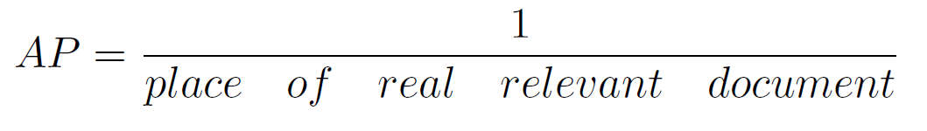
Evaluation
Average precision
Notes:
we select the embedding space of one language and map embedding spaces of all other languages to the selected space using the linear translation matrix model of Mikolov

Slide 12
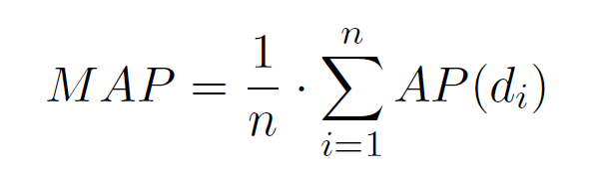
Evaluation
Mean Average precision
n = is the total number of queries
Our MAP is = 1234.0814/7886 = 0.1564

Slide 13
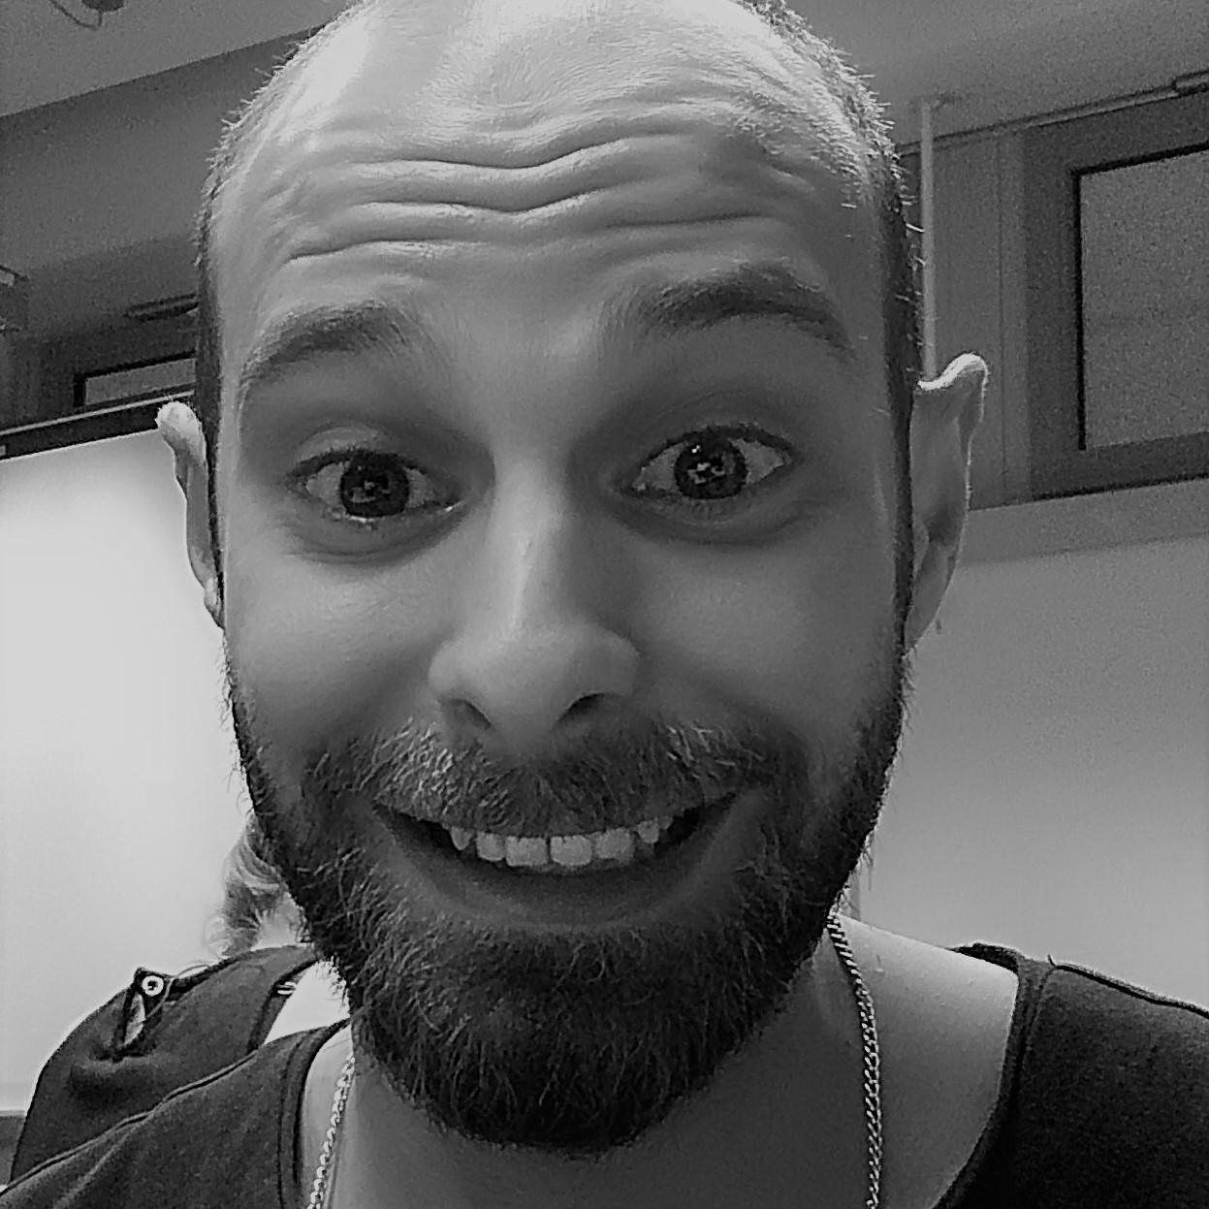
hello!
I am Ahmad
I am here because they told me there will be food.
@Ahmad.altaweel

Slide 14
1.
Documents embeddings
Explained

Slide 15
Document embeddings
Obtain the embedding vector for each word
Obtain the weight for each word
Calculate the embeddings for all documents in Spanish and English

Slide 16
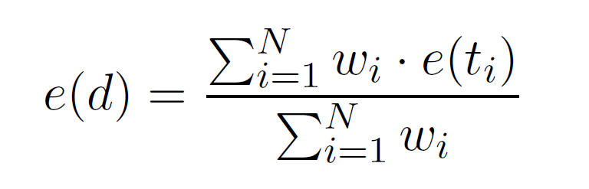
Document embeddings
Wi= the weight of the word.
e(ti)= the word vector embedding.
Notes:
we select the embedding space of one language and map embedding spaces of all other languages to the selected space using the linear translation matrix model of Mikolov

Slide 17

hello!
I am Daria
I am here because every team should have a girl.
dsadova@mail.uni-mannheim.de

Slide 18
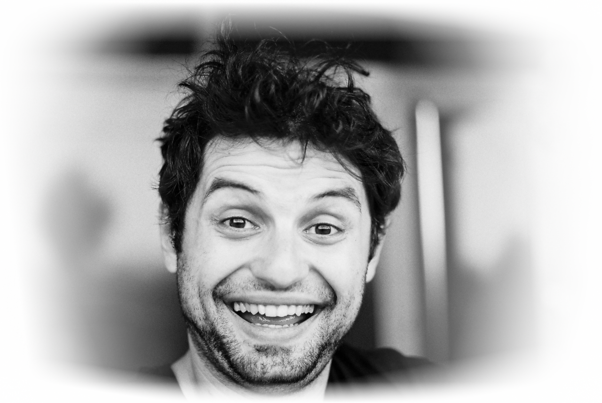
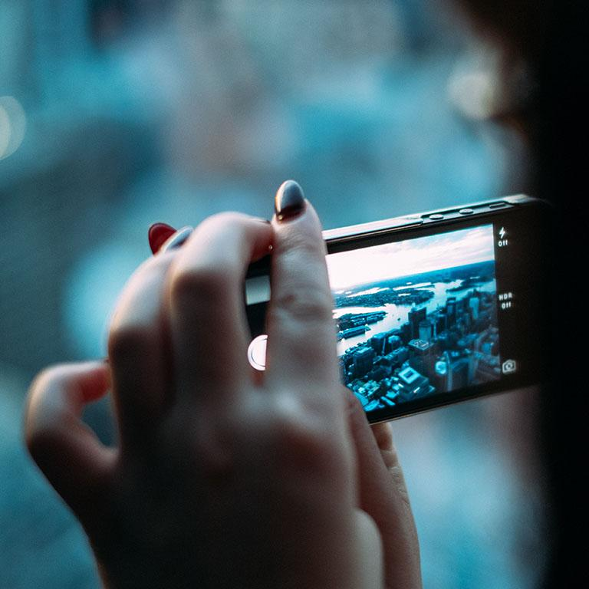
Acknowledgement
Thanks for your great support,
Frodo and Sam thank you too

Slide 19
Instructions for use
EDIT IN GOOGLE SLIDES
Click on the button under the presentation preview that says "Use as Google Slides Theme".
You will get a copy of this document on your Google Drive and will be able to edit, add or delete slides.
You have to be signed in to your Google account.
EDIT IN POWERPOINT®
Click on the button under the presentation preview that says "Download as PowerPoint template". You will get a .pptx file that you can edit in PowerPoint.
Remember to download and install the fonts used in this presentation (you’ll find the links to the font files needed in the Presentation design slide)
More info on how to use this template at www.slidescarnival.com/help-use-presentation-template
This template is free to use under Creative Commons Attribution license. You can keep the Credits slide or mention SlidesCarnival and other resources used in a slide footer.

Slide 20
Quotations are commonly printed as a means of inspiration and to invoke philosophical thoughts from the reader.

Slide 21
This is a slide title
Here you have a list of items
And some text
But remember not to overload your slides with content
Your audience will listen to you or read the content, but won’t do both.

Slide 22
big concept
Bring the attention of your audience over a key concept using icons or illustrations

Slide 23
You can also split your content
White
Is the color of milk and fresh snow, the color produced by the combination of all the colors of the visible spectrum.
Black
Is the color of coal, ebony, and of outer space. It is the darkest color, the result of the absence of or complete absorption of light.

Slide 24
In two or three columns
Yellow
Is the color of gold, butter and ripe lemons. In the spectrum of visible light, yellow is found between green and orange.
Blue
Is the colour of the clear sky and the deep sea. It is located between violet and green on the optical spectrum.
Red
Is the color of blood, and because of this it has historically been associated with sacrifice, danger and courage.

Slide 25
Acnowledgement
A complex idea can be conveyed with just a single still image, namely making it possible to absorb large amounts of data quickly.

Slide 26
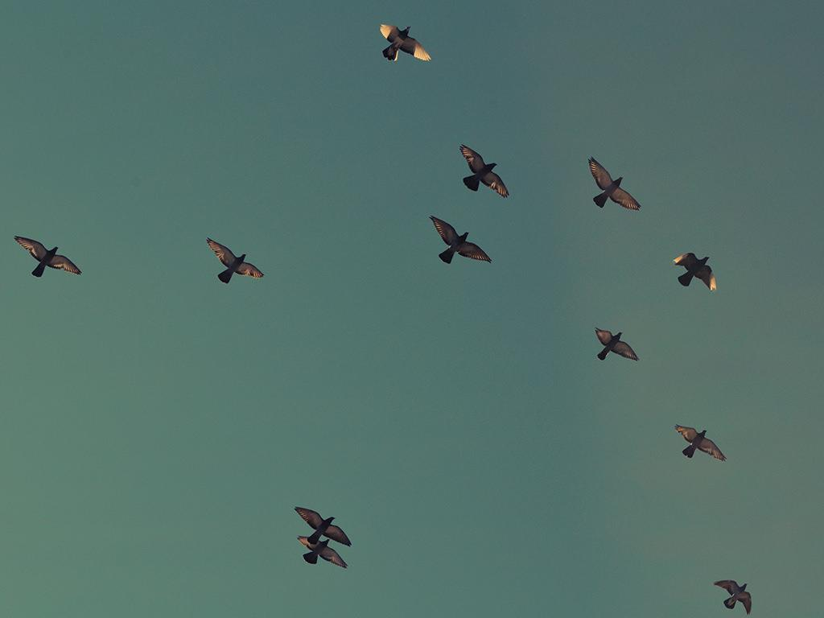
want big impact?
Use big image

Slide 27
Use charts to explain your ideas
White
Gray
Black

Slide 28
And tables to compare data
 | A | B | C
Yellow | 10 | 20 | 7
Blue | 30 | 15 | 10
Orange | 5 | 24 | 16

Slide 29
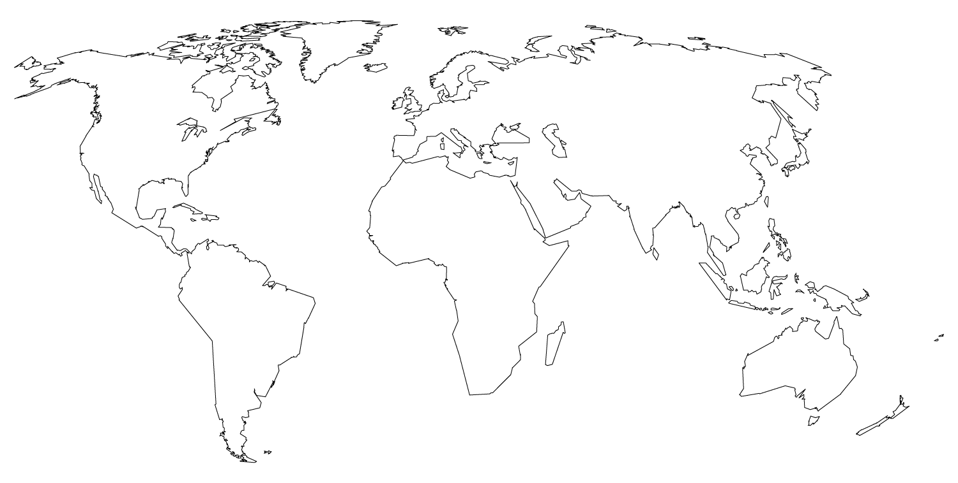
Maps
our office

Slide 30
89,526,124
Whoa! That’s a big number, aren’t you proud?

Slide 31
89,526,124$
185,244 users
100%
That’s a lot of money
And a lot of users
Total success!

Slide 32
Our process is easy
first
second
last

Slide 33
Let’s review some concepts
Yellow
Is the color of gold, butter and ripe lemons. In the spectrum of visible light, yellow is found between green and orange.
Blue
Is the colour of the clear sky and the deep sea. It is located between violet and green on the optical spectrum.
Red
Is the color of blood, and because of this it has historically been associated with sacrifice, danger and courage.
Yellow
Is the color of gold, butter and ripe lemons. In the spectrum of visible light, yellow is found between green and orange.
Blue
Is the colour of the clear sky and the deep sea. It is located between violet and green on the optical spectrum.
Red
Is the color of blood, and because of this it has historically been associated with sacrifice, danger and courage.

Slide 34
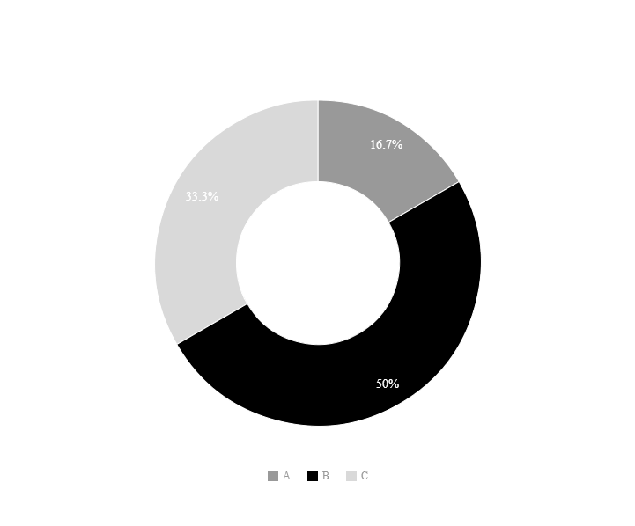
You can copy&paste graphs from Google Sheets

Slide 35
Android project
Show and explain your web, app or software projects using these gadget templates.
Place your screenshot here

Slide 36
iPhone project
Show and explain your web, app or software projects using these gadget templates.
Place your screenshot here

Slide 37
Tablet project
Show and explain your web, app or software projects using these gadget templates.
Place your screenshot here

Slide 38
Place your screenshot here
Desktop project
Show and explain your web, app or software projects using these gadget templates.

Slide 39
thanks!
You can find me at
@username
user@mail.me

Slide 40
Credits
Special thanks to all the people who made and released these awesome resources for free:
Presentation template by SlidesCarnival
Photographs by Unsplash

Slide 41

Presentation design
This presentations uses the following typographies:
Titles: Playfair Display
Body copy: PT Serif
You can download the fonts on this page:
https://www.google.com/fonts#UsePlace:use/Collection:Playfair+Display|PT+Serif
Click on the “arrow button” that appears on the top right
You don’t need to keep this slide in your presentation. It’s only here to serve you as a design guide if you need to create new slides or download the fonts to edit the presentation in PowerPoint®

Slide 42
SlidesCarnival icons are editable shapes.
This means that you can:
Resize them without losing quality.
Change line color, width and style.
Isn’t that nice? :)
Examples:

Slide 43
😉
Now you can use any emoji as an icon!
And of course it resizes without losing quality and you can change the color.
How? Follow Google instructions https://twitter.com/googledocs/status/730087240156643328
✋👆👉👍👤👦👧👨👩👪💃🏃💑❤😂😉😋😒😭👶😸🐟🍒🍔💣📌📖🔨🎃🎈🎨🏈🏰🌏🔌🔑 and many more...

